Slide 1
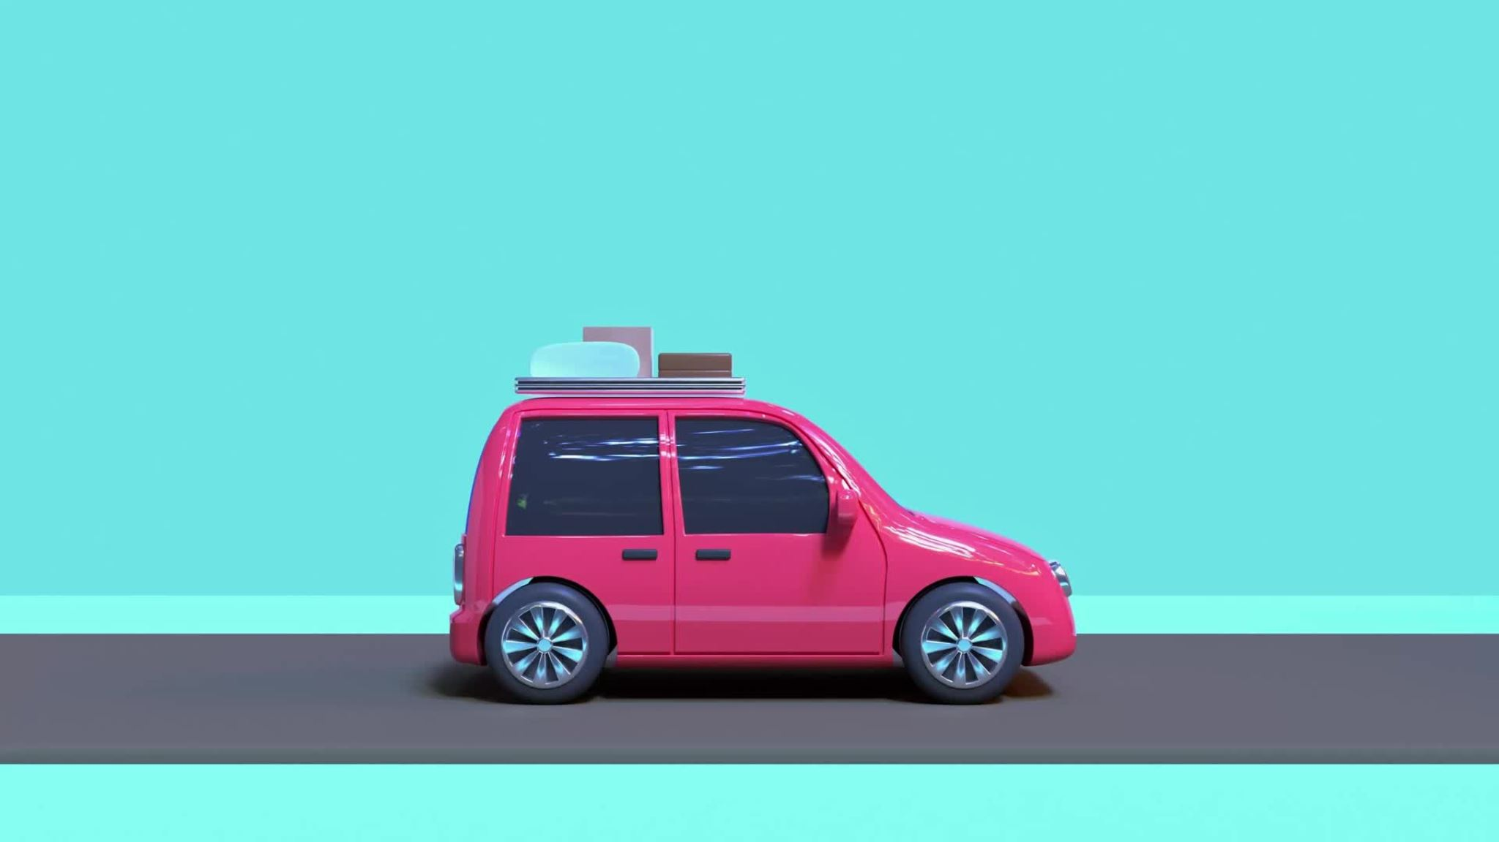
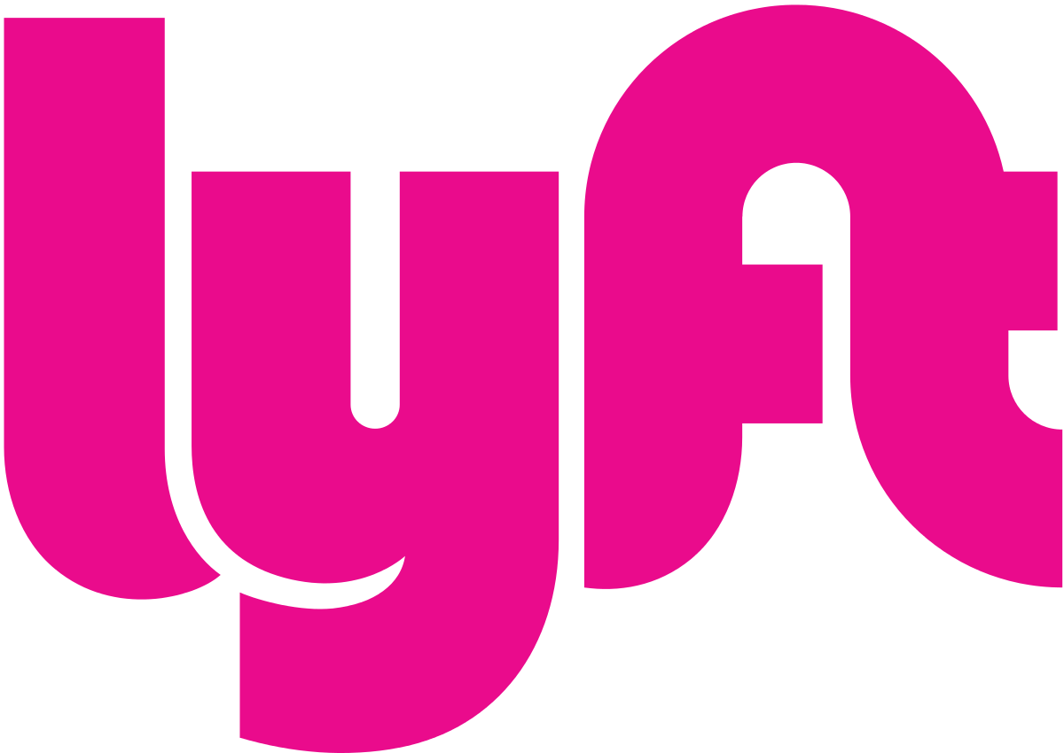

Slide 2
Introduction
Founding and Evolution: Lyft was founded in 2012 by Logan Green and John Zimmer as a service of Zimride, a long-distance carpooling platform they started in 2007. Initially focused on college transport, Lyft transitioned from Zimride to its own brand in May 2013.
Distinct Marketing Approach: Lyft gained attention with its unique marketing, featuring large pink furry mustaches on cars and encouraging riders to sit in the front seat and fist bump with drivers, creating a friendly and engaging experience.
Innovative Branding: To address concerns about the large mustaches, Lyft introduced the "glowstache" in January 2015, a small glowing plastic dashboard accessory as an alternative branding element for drivers.
Introduction of Shared Transport: In August 2014, Lyft expanded its services by introducing shared transport options, reflecting its commitment to innovative and efficient mobility solutions.

Slide 3
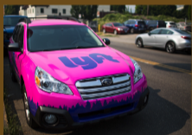
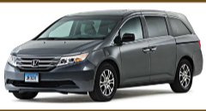


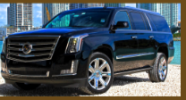
Marketing mix
Products
Lyft offers a wide variety of services.
Economy: most affordable options, using everyday vehicles
"Lyft"- 4 seats, cheapest
Lyft XL'-6 seats
Lux: most expensive, premium choice vehicles
Lyft Lux"- 4 seats, stylish
"Lux Black"- 4 seater, luxury SUV
"Lux Black XL"- 6 seater, luxury SUV

Slide 4
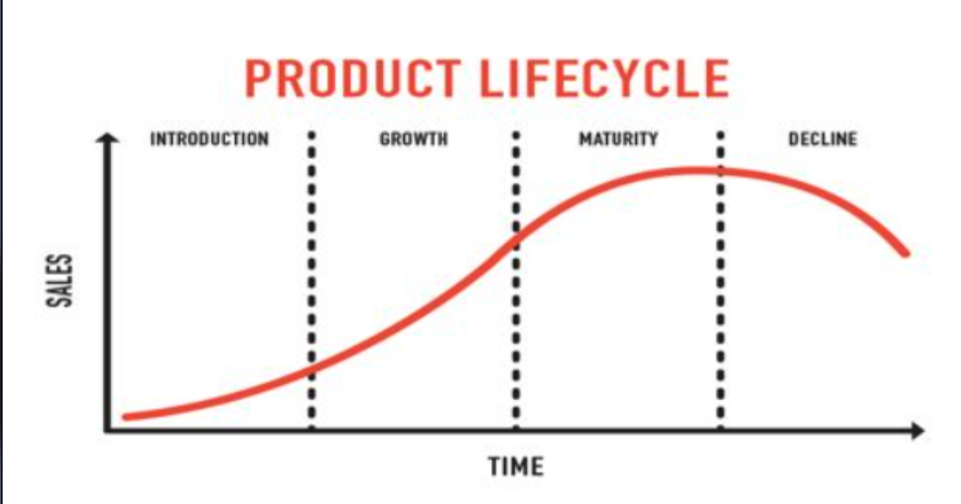
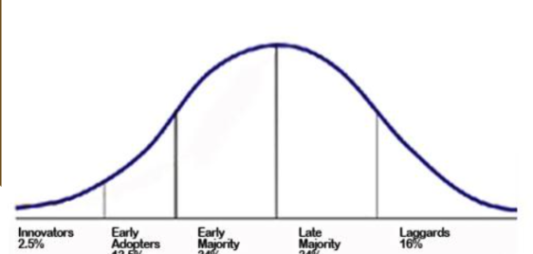
In my opinion, Lyft is in the growth-maturity stage. The company is beginning to be accepted over Uber and rapidly growing. Sales are increasing, but are not yet adopted by the late majority. Thus, it lies on the cusp of maturity.

Slide 5
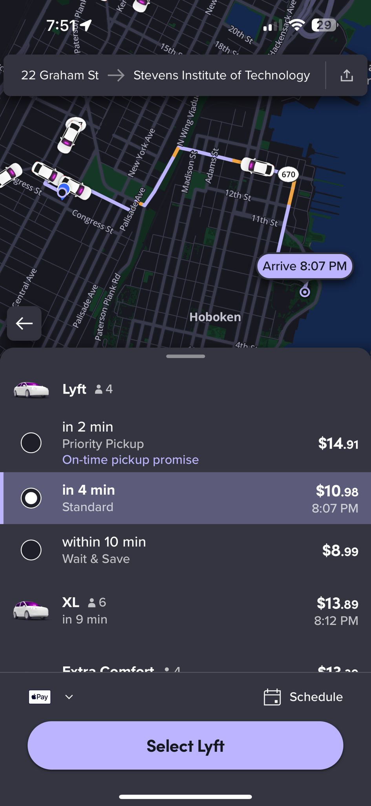
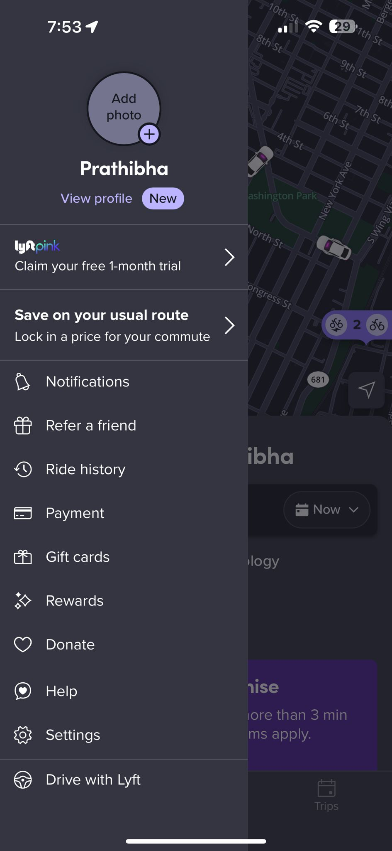
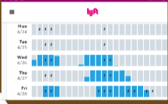
Place
All information regarding drivers and pickups is shown on the app.
• Simple sign up/log-in process
• Easy navigation and destination selection
• The app thus applies to a larger group of people
The app is for everyone
• Customers along with drivers, use the app
Drivers use it to:
• Schedule time on
• See pick-ups • GPS navigation • Get paid
Their website also provides additional information about company news, and the ability to do a limited amount of the app's features.

Slide 6
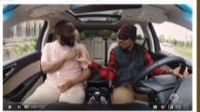
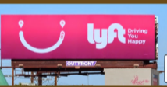
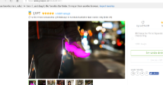
Lyft being primarily app and website based uses many promotion techniques.
Social Media Marketing -Their main form of advertisement is Youtube.
• Lyft hires celebrities to promote business
• Millions of people watch youtube
• Paid ads to display before videos
Promotion
Direct marketing ​
​
Lyft uses billboards or busses ​
• Designed to create product awareness ​
• Not for people to take action ​
​
Sales Promotions ​
​
Group on offers discounts on fares ​
• Both companies benefit​
​

Slide 7
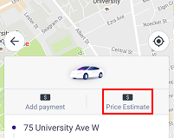
Dual Pricing Approach
Cost-based and value-based considerations.
Development costs: $604.5M in 2022.
Focus on app functionality and user experience.
Operating Expenses
Distribution costs driving $4.7B in revenue expenses (51.7% increase YoY).
Sales and marketing spend: $1.2B (85.6% increase YoY).
Flexible Fare Options
Varied ride types with demand-responsive pricing.
Average ride cost: $15.20 in the U.S.
Surge pricing during peak demand.
Price

Slide 8
SWOT Analysis
Strengths
Weakness
Strong Brand, Recognizable Nationwide
Loyal Customers, User-Friendly Interface
Innovative Services Expand Offerings
Advanced Technology that enhances Efficiency
Puny funding compared to Uber.
Same service as Uber.
Limited Focus, High Operational Costs
Regulatory Hurdles, Intense Market Competition
Opportunities
Threats
Global Expansion and Service Diversification
Strategic Partnerships and Market Focus
Technological Innovations and Business Evolution
Operational Efficiency and Revenue Streams
Regulatory Changes, Economic Shifts
Tech Disruptions, Legal Battles
Policy Shifts and Environmental Concerns
Intense Competition, Consumer Behavior Trends

Slide 9
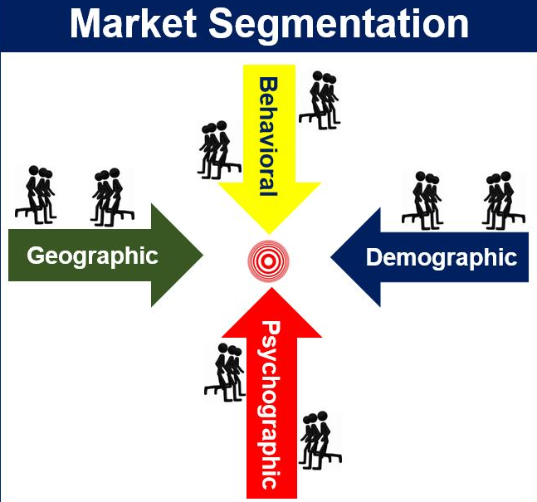
Segmentation strategies
Demographic Segmentation: Lyft targets a wide range of demographics, including different age groups like millennials and seniors, professions, and income levels. For example, premium services are aimed at higher-income individuals, while standard options cater to everyday budget-conscious riders.
Geographic Segmentation: The company focuses its services in urban and suburban regions where there is a high demand for quick and convenient transportation due to factors like traffic congestion and scarce parking. Services are tailored to meet the specific needs and regulations of each locality.
Behavioral Segmentation: Lyft analyzes user behavior such as frequency of rides, purpose (commute, leisure, etc.), and preferences (vehicle type, shared or solo rides). This helps them offer personalized promotions and service options like ride passes for frequent users or special rates during off-peak times.
Psychographic Segmentation: Lyft appeals to users based on lifestyle choices and values, promoting itself as an ethical choice with a focus on community and sustainability. This strategy attracts customers who prioritize social responsibility and prefer companies that align with their personal beliefs.
Technological Segmentation: Targeting users based on their comfort and familiarity with technology, Lyft provides varied service levels. Tech-savvy customers enjoy features like app integrations and real-time tracking, while less tech-oriented users might access Lyft services through simpler interfaces or partnerships.
Notes:
Lyft's segmentation strategy can be outlined across several key dimensions:
1. **Demographic Segmentation**: Lyft targets various demographic groups including millennials, working professionals, seniors, and families. This segmentation can also be based on income levels, with more premium services like Lyft Lux targeting higher-income users.
2. **Geographic Segmentation**: Lyft operates primarily in urban and suburban areas, focusing on dense cities where demand for ridesharing is high due to traffic congestion and limited parking. It also differentiates services based on region-specific needs and regulations.
3. **Behavioral Segmentation**: Lyft looks at customer travel patterns, preferences, and loyalty. For instance, frequent travelers might be targeted with ride passes or discounts, while occasional users might receive promotions to increase usage. The company also considers the time of day, with different strategies for peak and off-peak hours.
4. **Psychographic Segmentation**: This involves segmenting users based on their lifestyles, values, and social attitudes. Lyft has positioned itself as a socially responsible and driver-friendly brand, appealing to customers who value corporate ethics and sustainable practices.
5. **Technological Segmentation**: Lyft segments users by their adoption of technology, offering different levels of service to tech-savvy users who might prefer app-based services versus those who may use the service via other integrations, like partnerships with third-party apps or through corporate accounts.
By understanding and targeting these segments, Lyft can tailor its marketing strategies, service offerings, and customer interactions to meet the specific needs and preferences of its diverse user base.

Slide 10







Target Customers
Digital Native Teens
Gen X Parents
Local communities
and businesses
Opinion leaders, influencers
and personalities
Mainstream and
Niche media outlets
Brand Partnerships
Rideshare Competitors

Slide 11
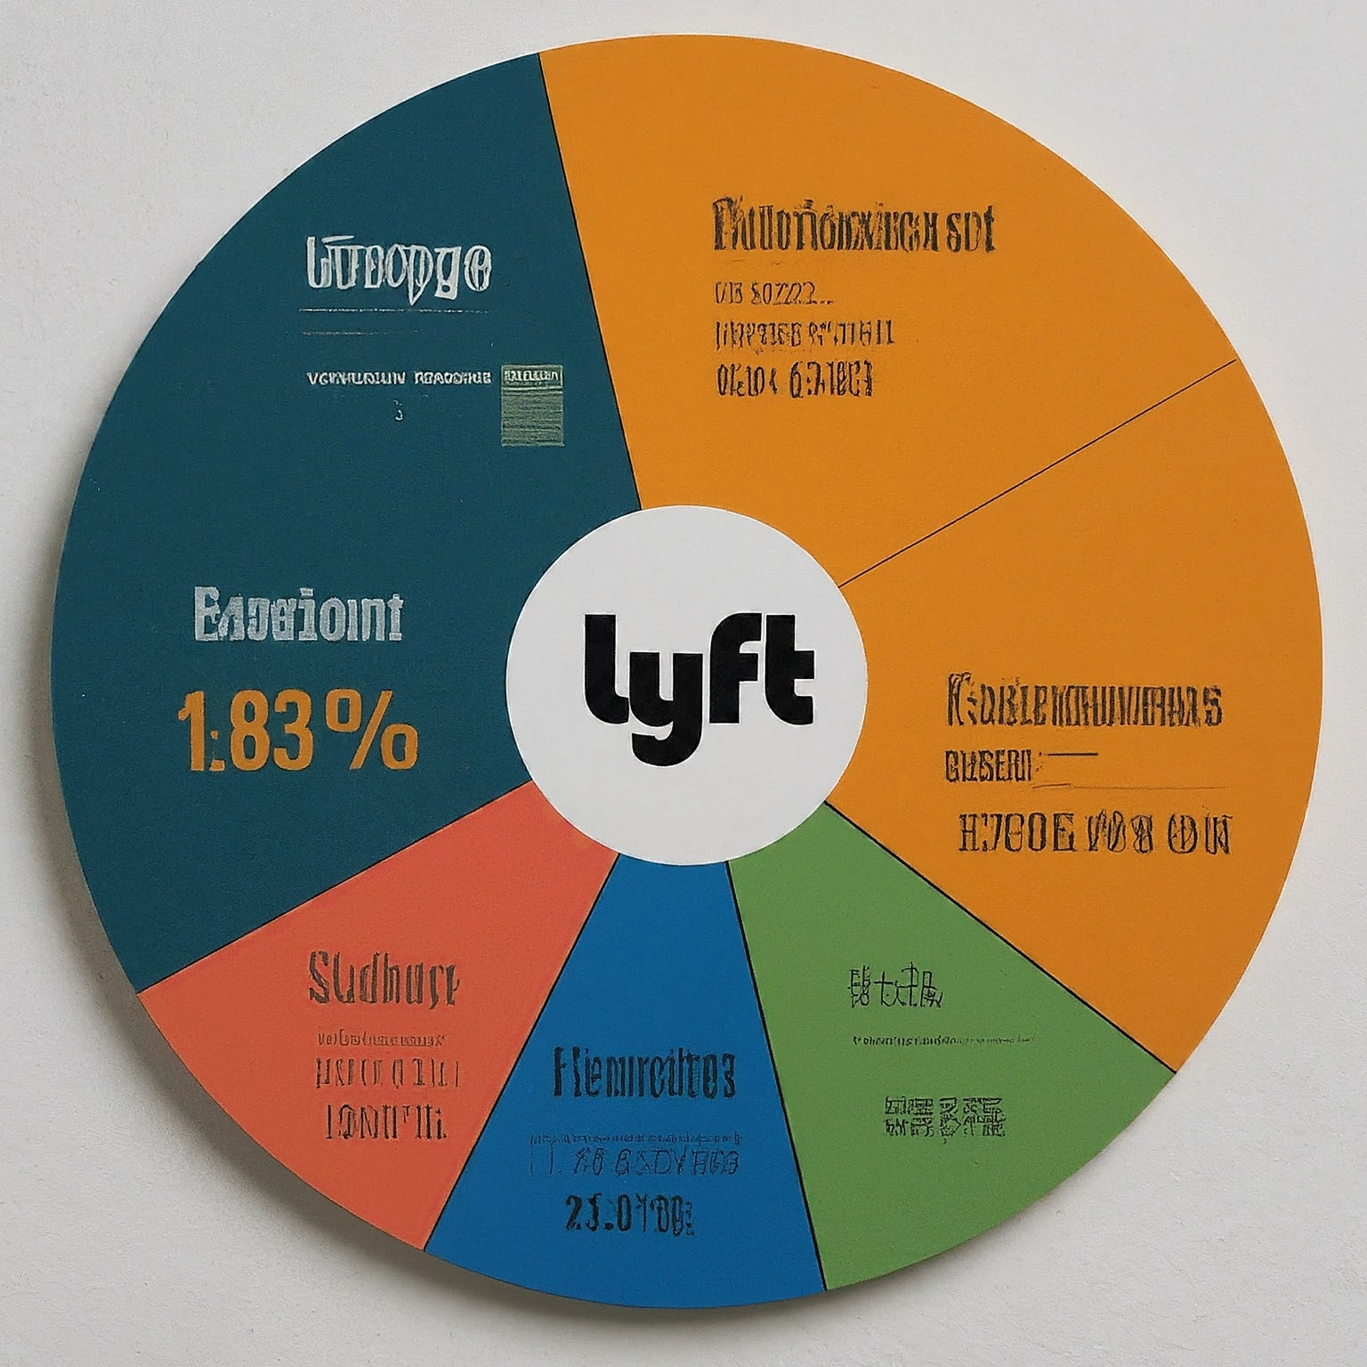
Lyft's Cluster Analysis
Unlock Rider Preferences: Using ride data (frequency, distance, and money), cluster analysis clusters similar riders.
Tailored price & Marketing: Personalised price plans and targeted advertising for every market group.
Personalised Rider Experience: Tailored app experiences to increase user loyalty and happiness.

Slide 12

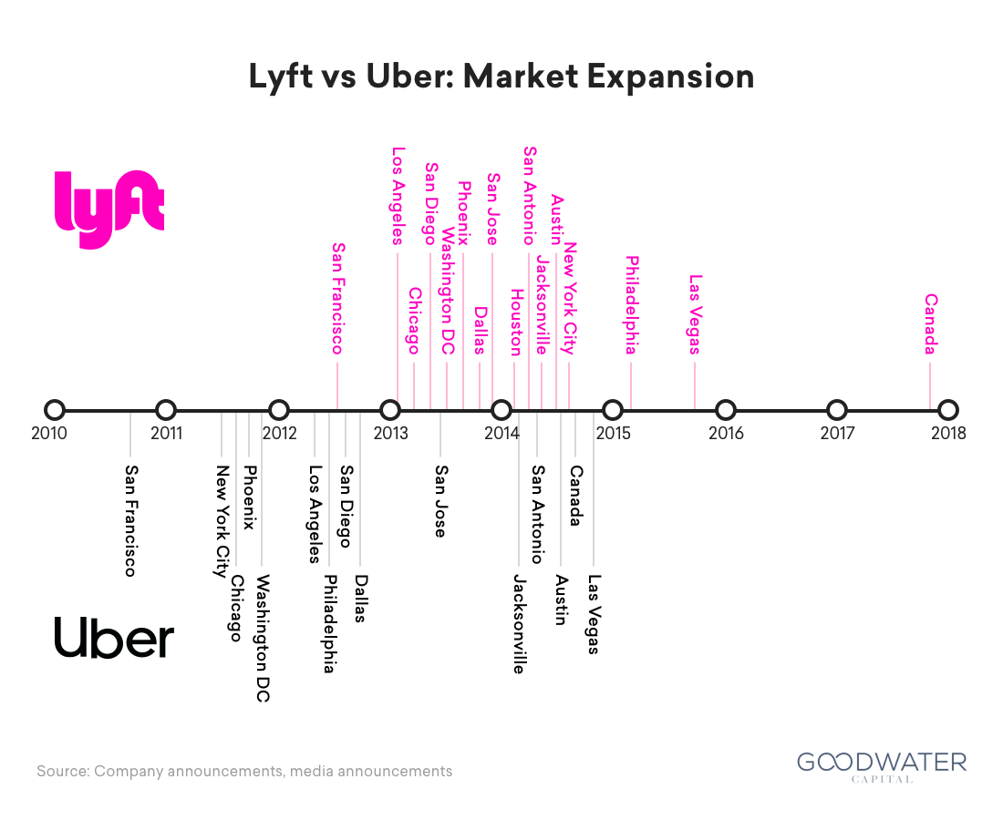
Expansion Plan
1. Geographic Expansion:
International Markets: Enter new international regions with favorable rideshare laws and demand.
Smaller Cities and Rural Areas: Expand to smaller urban and rural areas with adapted service models.
2. Service Diversification:
Freight and Delivery Services: Utilize network for parcel and grocery delivery services.
Expanded B2B Services: Offer business-specific transportation solutions, such as employee shuttles and event partnerships.
3. Technology and Innovation:
Autonomous Vehicles: Invest in self-driving technology to reduce costs and improve safety.
Enhanced App Features: Introduce advanced features like predictive booking and personalized options.

Slide 13
4. Partnerships:
Public Transit Integration: Collaborate with cities to integrate services with public transportation.
Corporate Partnerships: Forge new corporate relationships for employee commute programs.
5. Sustainability Initiatives:
Electrification of Fleet: Shift towards using electric vehicles to lower emissions.
Carbon Offset Programs: Offer customers options to offset emissions associated with their rides.
6. Marketing and Customer Engagement:
Localized Marketing Strategies: Tailor marketing efforts to fit local cultures and preferences.
Loyalty Programs: Develop loyalty incentives like discounts and ride credits for frequent users.

Slide 14
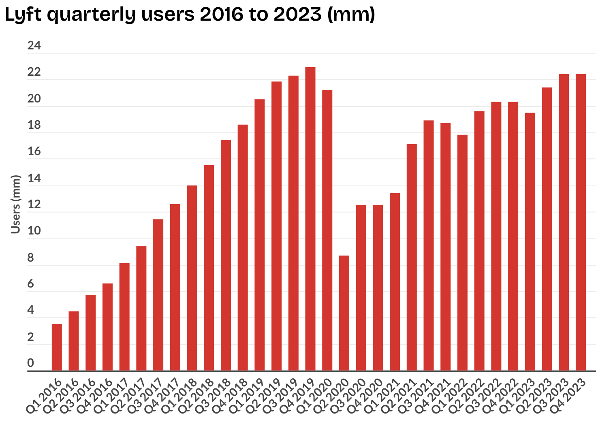
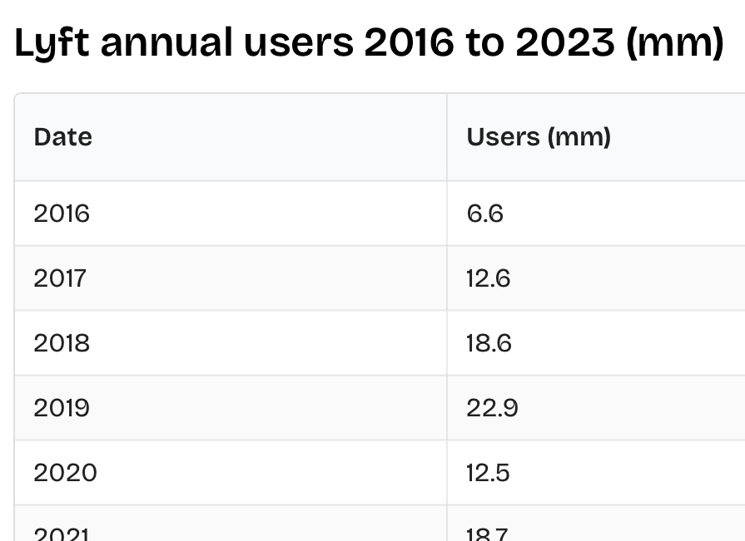
Revenue analysis
Cost of Revenue:
Analyzing the costs directly associated with generating revenue, such as driver payouts, incentives, insurance, and platform maintenance costs. Understanding these costs is crucial for evaluating profitability and optimizing operations.
Growth Analysis:
Examining revenue growth over time to assess the trajectory of Lyft's business. This includes year-over-year revenue growth rates, quarterly revenue trends, and comparisons with industry benchmarks.
Market Share Analysis:
Assessing Lyft's revenue share within the broader ride-hailing and transportation market. This involves comparing Lyft's revenue with competitors like Uber and analyzing shifts in market dynamics.
Regulatory Impact:
Evaluating the impact of regulatory changes on Lyft's revenue. Changes in regulations related to ride-hailing, transportation, labor laws, and data privacy can influence Lyft's revenue streams and profitability.

Slide 15
Revenue | US$4.40 billion (2023)
Operating income | US$−476 million (2023)
Net income | US$−340 million (2023)
Total assets | US$4.56 billion (2023)
Total equity | US$541 million (2023)
Number of employees | 2,945 (2023)

Slide 16

Forecasting
Financial Performance: Analysts predict Lyft will become profitable within the next 3 years, with significant growth in earnings per share (EPS). Revenue is also expected to rise, but at a slower pace.
Market Growth: The ride-hailing industry is expected to experience continued growth, potentially benefitting Lyft's rider demand. However, competition from Uber and emerging autonomous vehicle companies will influence Lyft's market share.
Revenue Growth Publicly available information suggests Lyft's revenue growth will be steady, with analyst estimates suggesting an around 11% annual increase over the next few years.
Earnings Growth - Analysts are more bullish on Lyft's earnings, predicting a significant increase in EPS. Estimates suggest an annual growth rate of around 75% over the next 3 years.

Slide 17
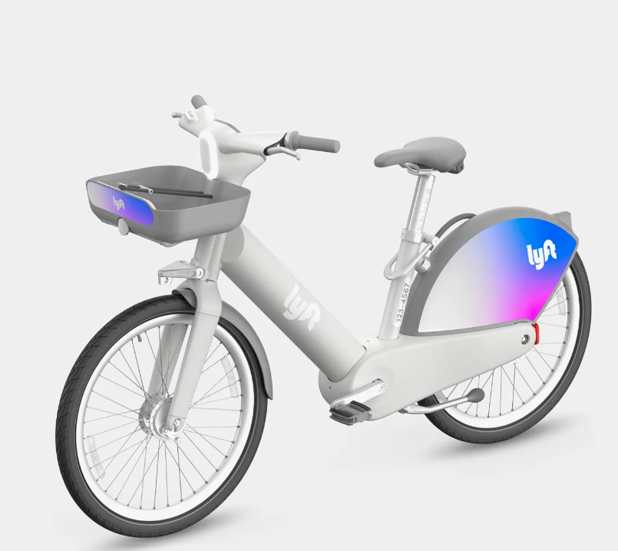
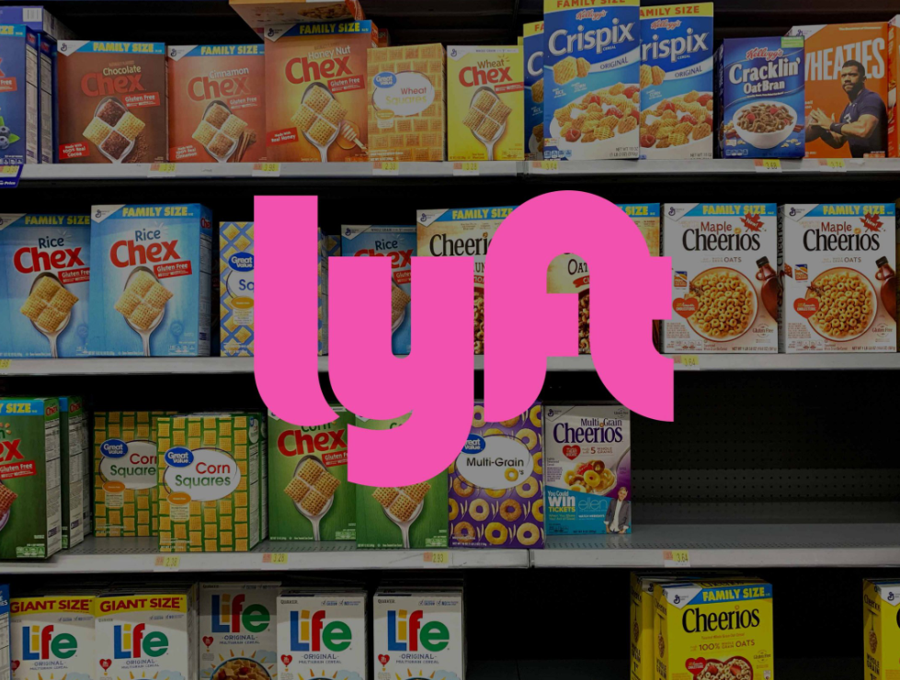
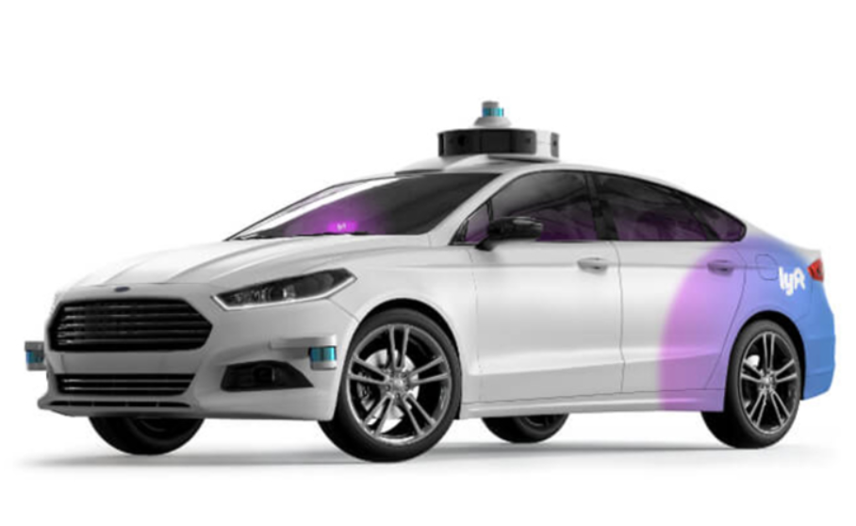
Diversification
Expansion into Other Transportation Services: Diversifying beyond ride-sharing to include bike-sharing, scooters, and other mobility options.
Delivery Services: Leveraging existing infrastructure and driver network to offer food, grocery, and goods delivery services.
Partnerships and Alliances: Strategic collaborations with autonomous vehicle companies and other industry players.
Investment in Autonomous Vehicles: Research and development efforts towards self-driving technology to potentially reduce dependence on human drivers.
New Markets: International expansion and penetration into underserved areas to capture new customer segments.

Slide 18
STP (Segmentation, Targeting, Positioning)
Aspect of STP Strategy | Description
Segmentation | - Demographics: Targeting specific age, income, and occupation groups to tailor services and promotions. - Usage Behavior: Understanding ride patterns, frequency, and preferences (e.g., ride types, distances).
 | - Geographic: Focusing on urban centers, college campuses, and high-demand areas for optimized service coverage. - Psychographic: Considering lifestyle, values, and attitudes for targeted marketing.
Targeting | - Millennials and Urban Dwellers: Meeting the needs of younger, city-dwelling customers seeking convenience and sustainability in transportation.
 | - Business Travelers: Offering tailored services like expense management tools and reliable airport transportation for corporate clients.
Positioning | - Convenient and Affordable: Emphasizing Lyft as a cost-effective and flexible alternative to car ownership.
 | - Safety and Trust: Building trust through safety features, driver background checks, real-time tracking, and responsive customer support.
 | - Differentiation: Showcasing unique benefits such as community engagement, driver incentives, and user-friendly app experience.
 | - Social Responsibility: Demonstrating Lyft's commitment to social causes through initiatives like LyftUp and sustainability efforts.

Slide 19


